Slide 1
Exercise - Learning Objectives
By the end of this exercise you will be able to:
Define an emission (e.g. CO₂) to be considered in the model
Define an emissions penalty (e.g. carbon tax)
Define emission ratios for each technology
Set up an emissions target
Account for emissions not captured by the defined system

Slide 2
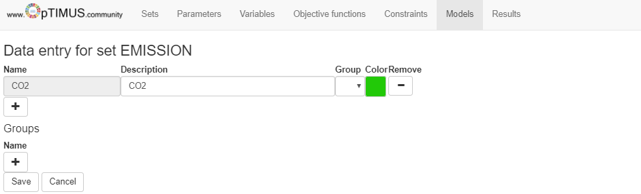
Defining emissions
The first step is to decide which type of emissions we are interested in. In this example, we will look at carbon dioxide.
Create a new item in the set Emission called CO2.

Slide 3
Representing emissions
The following parameters can be taken into account
EmissionActivityRatio: defines the rate of emission by each technology
EmissionsPenalty: defines the cost per unit of emission
AnnualExogenousEmission: defines annual level of emissions not captured by the considered system, but that should be accounted for.
AnnualEmissionLimit: sets an annual upper limit on the total emissions of a particular pollutant.
ModelPeriodExogenousEmission: defines model period level of emissions not captured by the considered system, but that should be accounted for.
ModelPeriodEmissionLimit: sets an upper limit on the model period on the total emissions of a particular pollutant.

Slide 4
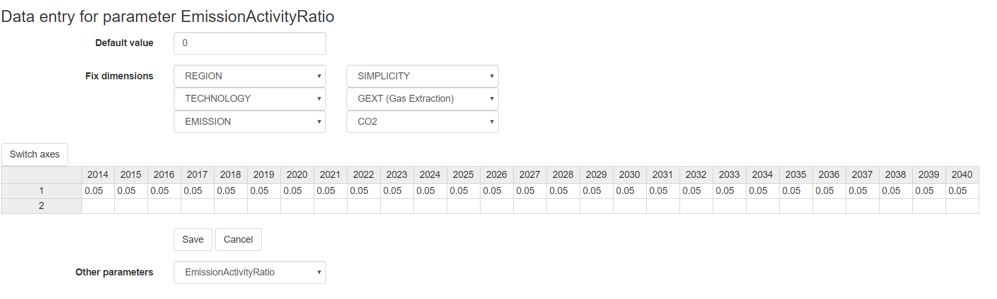
Representing emissions
For the GasExtraction and GasImport technologies, let’s define the following.
EmissionActivityRatio: Insert the following for mode of operation 1.
Emission | 2014 | 2015 | 2016 | 2017 | 2018 | 2019 | 2020 | 2021 | 2022
CO2 | 0.05 | 0.05 | 0.05 | 0.05 | 0.05 | 0.05 | 0.05 | 0.05 | 0.05
 | 2023 | 2024 | 2025 | 2026 | 2027 | 2028 | 2029 | 2030 | 2031
CO2 | 0.05 | 0.05 | 0.05 | 0.05 | 0.05 | 0.05 | 0.05 | 0.05 | 0.05
 | 2032 | 2033 | 2034 | 2035 | 2036 | 2037 | 2038 | 2039 | 2040
CO2 | 0.05 | 0.05 | 0.05 | 0.05 | 0.05 | 0.05 | 0.05 | 0.05 | 0.05

Slide 5
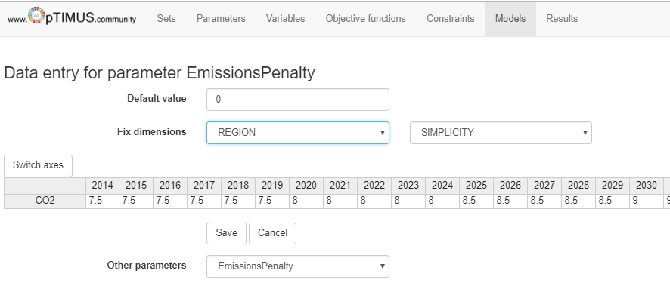
Representing emissions
For the CO2 emission, let’s define the following.
EmissionsPenalty: Insert the following for mode of operation 1.
 | 2014 | 2015 | 2016 | 2017 | 2018 | 2019 | 2020 | 2021 | 2022
CO2 | 7.5 | 7.5 | 7.5 | 7.5 | 7.5 | 7.5 | 8 | 8 | 8
 | 2023 | 2024 | 2025 | 2026 | 2027 | 2028 | 2029 | 2030 | 2031
CO2 | 8 | 8 | 8.5 | 8.5 | 8.5 | 8.5 | 8.5 | 9 | 9
 | 2032 | 2033 | 2034 | 2035 | 2036 | 2037 | 2038 | 2039 | 2040
CO2 | 9 | 9 | 9 | 9.5 | 9.5 | 9.5 | 9.5 | 9.5 | 10
Notes:
Mode of operation is not needed.

Slide 6
Representing emissions
For the CO2 emission, let’s define the following.
AnnualEmissionLimit: Insert the following values
 | 2014 | 2015 | 2016 | 2017 | 2018 | 2019 | 2020 | 2021 | 2022
CO2 | 9999 | 9999 | 9999 | 9999 | 9999 | 9999 | 9999 | 9999 | 9999
 | 2023 | 2024 | 2025 | 2026 | 2027 | 2028 | 2029 | 2030 | 2031
CO2 | 9999 | 9999 | 9999 | 9999 | 9999 | 9999 | 9999 | 0.2 | 0.18
 | 2032 | 2033 | 2034 | 2035 | 2036 | 2037 | 2038 | 2039 | 2040
CO2 | 0.16 | 0.14 | 0.12 | 0.1 | 0.09 | 0.08 | 0.07 | 0.06 | 0.05

Slide 7
Exogenous emissions
Let’s assume that there is exogenous CO2 emissions in agriculture and forestry that need to be accounted for.
AnnualExogenousEmission: Insert the following values
 | 2014 | 2015 | 2016 | 2017 | 2018 | 2019 | 2020 | 2021 | 2022
CO2 | 0.05 | 0.05 | 0.05 | 0.05 | 0.05 | 0.05 | 0.05 | 0.05 | 0.05
 | 2023 | 2024 | 2025 | 2026 | 2027 | 2028 | 2029 | 2030 | 2031
CO2 | 0.05 | 0.05 | 0.05 | 0.05 | 0.05 | 0.05 | 0.05 | 0.05 | 0.05
 | 2032 | 2033 | 2034 | 2035 | 2036 | 2037 | 2038 | 2039 | 2040
CO2 | 0.05 | 0.05 | 0.05 | 0.05 | 0.05 | 0.05 | 0.05 | 0.05 | 0.05

Slide 8
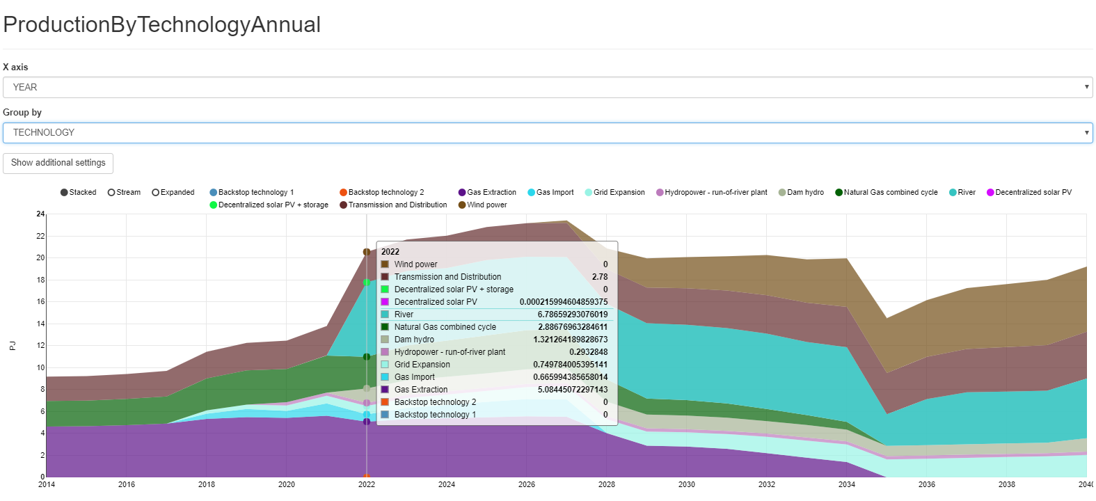
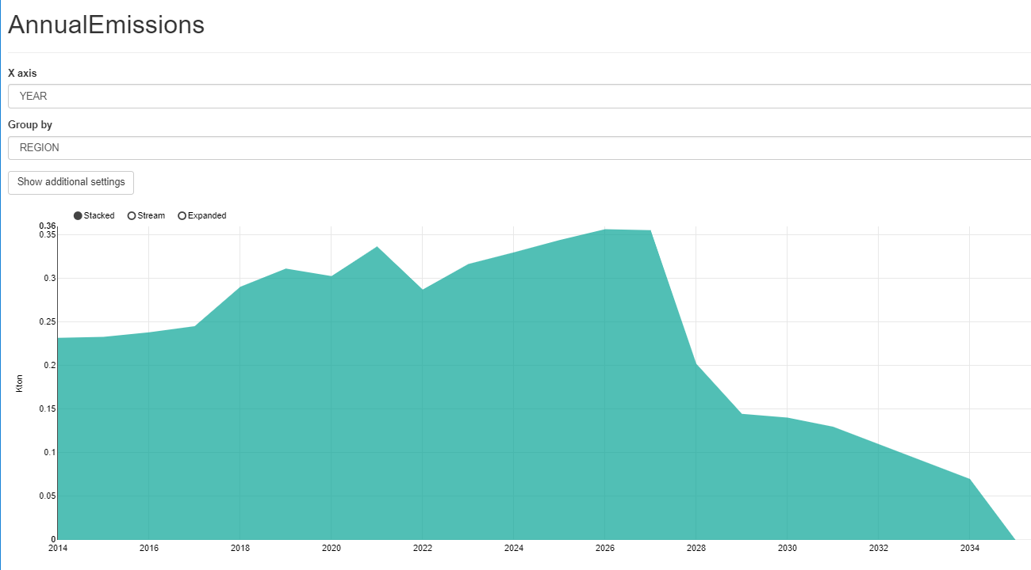
Run the model and check the results!
Changelog and Attribution

